Slide 1
FRICH MARTÍNEZ DE VELASCO Y ASOCIADOS ABOGADOS, ATTORNEYS AT LAW
Since 1997 / 20Th. Anniversary
FRICH MARTÍNEZ DE VELASCO Y ASOCIADOS, ABOGADOS, ATTORNEYS AT LAW, S.C.
Tels. & Fax: (52) (55) 4593-4590
www.fmvabogados.com.mx

Slide 2
In FRICH MARTÍNEZ DE VELASCO & ASOCIADOS, are one of the leading Law Firms in Mexico, we have over 20 years offering our services to domestic and foreign companies and governments.
We have had offices in Washington, DC, Dallas, Texas and in Santa Ana, California.
We are the first Mexican Law Firm opened offices directly and independently in Washington, DC
Since 1997 / 20Th. Anniversary
FRICH MARTÍNEZ DE VELASCO Y ASOCIADOS, ABOGADOS, ATTORNEYS AT LAW, S.C.
Tels. & Fax: (52) (55) 4593-4590
www.fmvabogados.com.mx

Slide 3
Our MISSION
Providing to Our Clients Legal - Financial and Business Security and Certainty
Protecting Your Interests and Expanding Your Utilities As Well As Create Tangible and Measurable Benefits
Since 1997 / 20Th. Anniversary
FRICH MARTÍNEZ DE VELASCO Y ASOCIADOS, ABOGADOS, ATTORNEYS AT LAW, S.C.
Tels. & Fax: (52) (55) 4593-4590
www.fmvabogados.com.mx

Slide 4
We are a International Law - Financial Firm with experience in complex operations and highly specialized services.
Counseling and Defending for businesses, governments and individuals.
Financial Structuring
Business Counseling
Since 1997 / 20Th. Anniversary
FRICH MARTÍNEZ DE VELASCO Y ASOCIADOS, ABOGADOS, ATTORNEYS AT LAW, S.C.
Tels. & Fax: (52) (55) 4593-4590
www.fmvabogados.com.mx

Slide 5
We are known for the high level of knowledge, expertise, international business and government relations.
The highest degree of loyalty and honor towards our Clients.
Since 1997 / 20Th. Anniversary
FRICH MARTÍNEZ DE VELASCO Y ASOCIADOS, ABOGADOS, ATTORNEYS AT LAW, S.C.
Tels. & Fax: (52) (55) 4593-4590
www.fmvabogados.com.mx

Slide 6
Alliances
For many years FRICH MARTÍNEZ DE VELASCO Y ASOCIADOS we have maintained professional relationships with some of the largest international Firms around the world, such as with:
Winston & Strawn
Dentons
Winsted PC
Guangzhou Huaxue Intellectual Property Agency Co.
In this way we can offer our Clients advice and defense of their interests in the principal countries of the five continents.
Since 1997 / 20Th. Anniversary
FRICH MARTÍNEZ DE VELASCO Y ASOCIADOS, ABOGADOS, ATTORNEYS AT LAW, S.C.
Tels. & Fax: (52) (55) 4593-4590
www.fmvabogados.com.mx

Slide 7
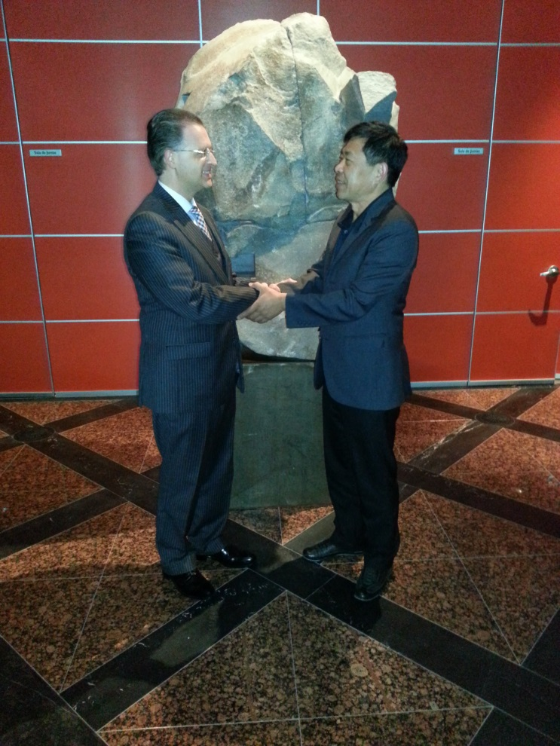
Alliances
We also have strategic partnerships in America, Europe and Asia:
International Investment Funds
Investor Groups
Business Groups
Since we are a natural source of new business and create synergies among our customers.
Since 1997 / 20Th. Anniversary
FRICH MARTÍNEZ DE VELASCO Y ASOCIADOS, ABOGADOS, ATTORNEYS AT LAW, S.C.
Tels. & Fax: (52) (55) 4593-4590
www.fmvabogados.com.mx

Slide 8
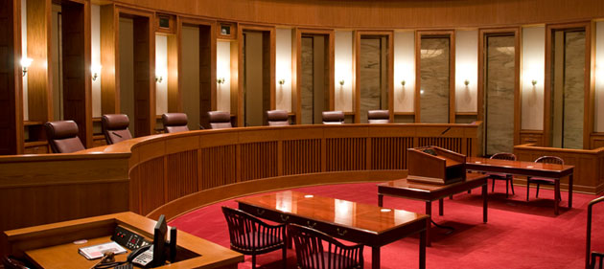
PARTNERS
H.G. Duke Don Kristian Frich Martínez de Velasco di Silkeborg
José Luis de la Torre Dávila
Sergio Aguilar Álvarez
Gustavo Aviña Zavala
Ging Kuo Long
Since 1997 / 20Th. Anniversary
FRICH MARTÍNEZ DE VELASCO Y ASOCIADOS, ABOGADOS, ATTORNEYS AT LAW, S.C.
Tels. & Fax: (52) (55) 4593-4590
www.fmvabogados.com.mx

Slide 9
Areas of Expertise
Arbitration (international, corporate, commercial and governmental)
Aviation & Aerospace
Banking and International Finance System
Bindings (Governmental and Private)
Capital Markets
Certificates of Capital Developments in Infrastructure (CKDs)
Corporate Governance
Corporate Law
Compliance with Foreign Laws
Diplomacy
Energy (Electricity, Oil and Gas)
Financial (corporate finance in general, project finance, guaranteed financing, leasing, factoring)
Gambling
Government Contracts
Governmental Law
Heritages
Housing
Hotels
Infrastructure
Immigration
International Investments
International Public Law
International Trade
Insolvency
Since 1997 / 20Th. Anniversary
FRICH MARTÍNEZ DE VELASCO Y ASOCIADOS, ABOGADOS, ATTORNEYS AT LAW, S.C.
Tels. & Fax: (52) (55) 4593-4590
www.fmvabogados.com.mx

Slide 10
Areas of Expertise
Intellectual Property
International Estate Planning
Investment Trust Real Estate (FIBRAS)
Investment Funds
Lobbying
Mergers and Acquisitions
Mining
Natural Resources
Negotiations with Governments
Negotiations with Companies
Ports
Public Private Partnerships (PPP)
Real Estate
Regulated and Unregulated Financial Entities
Restructuring
Retirement Funds
Telecommunications
Tourism
Transportation
Technology
Trusts
Since 1997 / 20Th. Anniversary
FRICH MARTÍNEZ DE VELASCO Y ASOCIADOS, ABOGADOS, ATTORNEYS AT LAW, S.C.
Tels. & Fax: (52) (55) 4593-4590
www.fmvabogados.com.mx

Slide 11
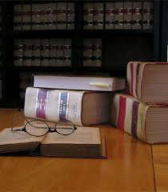
INDUSTRIES AND SECTORS
Aviation
Airports
Agricultural
Banking
Communications
Construction
Data Centers
Energy
Financial
Gambling
Gas
Government
Housing
Hoteliers
Infrastructure
International Trade
Mining
National Security
Oil
Ports
Real Estate
Telecommunications
Transport
Since 1997 / 20Th. Anniversary
FRICH MARTÍNEZ DE VELASCO Y ASOCIADOS, ABOGADOS, ATTORNEYS AT LAW, S.C.
Tels. & Fax: (52) (55) 4593-4590
www.fmvabogados.com.mx

Slide 12
Clients Some Major Clients that we have the Honor and Pride Deep advise, represent and Defender are:
Al Manhal International Group
Aladia Airlines
America ATE
ASPA de Mexico
Atlantic Littoral Group
Aviarrendamientos Airlines
Basilica of Guadalupe
Bytech Technologies
CMIC - Mexican Chamber of Construction Industry.
Crown of Saint Stephen
Chatsworth Securities
CONPAPA, National Confederation of Potato Growers
Cyma Credit Union
Drillco Internacional
Embassy of the Netherlands
Familiar Remittances Mexican Association
Filiangery
Foli Organic
Fundacion Mexicanos en el Exterior
Guanajuato State
Grubsa
Grupo Marhnos
Inbisa
Integraciones y Construcciones del Sureste
International Arbitration in the Binational Panel NAFTA for North America on Cement, Portland Cement and Clinker Gray from Mexico.
Since 1997 / 20Th. Anniversary
FRICH MARTÍNEZ DE VELASCO Y ASOCIADOS, ABOGADOS, ATTORNEYS AT LAW, S.C.
Tels. & Fax: (52) (55) 4593-4590
www.fmvabogados.com.mx

Slide 13
Clients
IPADE – Instituto Panamericano de Alta Dirección de Empresas
Isolux Corsan
La Fama Montañesa Fabrica de Hilados y Tejidos de Algodon
Laeca
Lanzagorta Group
MexDer Mexican Derivatives Market
Mexican Trade Center
Notre Dame University
OME Organización de Mexicanos en el Exterior
Operadora Hotelera Sinaloense, DLV
OZ Group
Parque Industrial Internacional
Principality of Saint Stephen
Program of Distribution Centers in USA of the Mexican Government
Presidency of Mexico
Real Snow
Rene Produce
Saint Stephen Crown’s Depository, Central Bank of the Crown of Saint Stephen
Servicios Administrativos Oecomonus, SOFOM
Sime, AG
Thyssenkup Mexinox
Three-Mode Automation & Research
Universidad Panamericana
Westin Regina
Wind Energy Group
Worldwide Terminal Services
World Tuna Development
WPP Energy, World Power Production
Since 1997 / 20Th. Anniversary
FRICH MARTÍNEZ DE VELASCO Y ASOCIADOS, ABOGADOS, ATTORNEYS AT LAW, S.C.
Tels. & Fax: (52) (55) 4593-4590
www.fmvabogados.com.mx

Slide 14
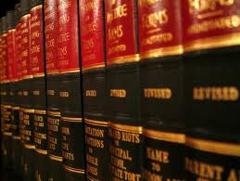
Some of the issues and cases that we have the honor of advising, defending and represented are:
We advise the Crown of Saint Stephen in all its worldwide investments, as are:
Saint Stephens Crown Depsoitory, Central Bank of the Crown of Saint Stephen
Investments in México, Brasil, Paraguay and the Caribean.
We advise the Crown of Saint Stephen in International Public Law and Diplomacy.
Since 1997 / 20Th. Anniversary
FRICH MARTÍNEZ DE VELASCO Y ASOCIADOS, ABOGADOS, ATTORNEYS AT LAW, S.C.
Tels. & Fax: (52) (55) 4593-4590
www.fmvabogados.com.mx

Slide 15
We advice and structure the contract for Investment and Securitization of more than US $ 200 billion, the largest transaction of a Mexican Law Firm structured. And we are the Firm to monitor its correct operation market globally.
We advise in the structuring and issued of the Saint Stephen Pound (SPP Series A) in the form of Cryptocurrency legal tender of His Majesty Don Vincenzo Davide I, the emission was for 1.1 Trillion SPP Sereies A, with a value of 1 SPP Series A per 1 USD, being the largest emission of a cryptocurrency and the first legal tender cryptocurrency worldwide.
Since 1997 / 20Th. Anniversary
FRICH MARTÍNEZ DE VELASCO Y ASOCIADOS, ABOGADOS, ATTORNEYS AT LAW, S.C.
Tels. & Fax: (52) (55) 4593-4590
www.fmvabogados.com.mx

Slide 16
We are the Law Firm of the largest real estate is in a capital city of the 20 largest economies in the world, value in more than USD $90 billion, owner of 5700 hectares (14085 acres) in Mexico city.
Defend litigation in real estate for over USD $10 billion, which allows us to be Mexican Firm Attorneys representing higher amounts in real estate litigation.
We are negotiating the payment of an international compensations for expropriations for more than US $20 billion, which allows us to be Mexican Firm Attorneys representing higher amounts in collection.
We are regularizing invaded properties in the City of Mexico for an area of ​​over 1,300 hectares (3212 acres) and a value of USD $1.5 billion.
Since 1997 / 20Th. Anniversary
FRICH MARTÍNEZ DE VELASCO Y ASOCIADOS, ABOGADOS, ATTORNEYS AT LAW, S.C.
Tels. & Fax: (52) (55) 4593-4590
www.fmvabogados.com.mx

Slide 17
We are advising and representing legally and financially the construction of the tallest skyscraper in the Western Hemisphere and is the biggest real estate development in the American continent with more than 700 meters high, and an investment of USD $ 7 billion.
We are advising and representing several oil, gas and electricity developments, bindings, project finance and contracts with governments and with suppliers, in México, Venezuela, Canada and China.
We are structuring the project finance to build 100,000 popular houses in Mexico.
Since 1997 / 20Th. Anniversary
FRICH MARTÍNEZ DE VELASCO Y ASOCIADOS, ABOGADOS, ATTORNEYS AT LAW, S.C.
Tels. & Fax: (52) (55) 4593-4590
www.fmvabogados.com.mx

Slide 18
For further information please contact:
His Grace Duke Don Kristian Frich Martínez de Velasco di Silkeborg, Esq.
Chairman and CEO
FRICH MARTÍNEZ DE VELASCO Y ASOCIADOS
ABOGADOS, ATTORNEYS AT LAW, S.C.
(52) (55) 4593-4590
kfrich@fmvabogados.com.mx
www.fmvabogados.com.mx
Skype: kristianfrich
Twitter: @kristianfrich
Since 1997 / 20Th. Anniversary
FRICH MARTÍNEZ DE VELASCO Y ASOCIADOS, ABOGADOS, ATTORNEYS AT LAW, S.C.
Tels. & Fax: (52) (55) 4593-4590
www.fmvabogados.com.mx

